Slide 1
Angular
Anil K

Slide 2
Custom Observables using Services - Example
Creating Application
Open Command Prompt and enter the following commands:
cd c:\angular
ng new app1
cd c:\angular\app1
ng g component India
ng g component Usa
ng g service Population

Slide 3
c:\angular\app1\src\app\population.service.ts
import { Injectable } from '@angular/core';
import { Observable, Observer } from "rxjs";
@Injectable() export class PopulationService {
myObservable: Observable<number>;
myObserver!: Observer<number>;
constructor() {
this.myObservable = new Observable((observer: Observer<number>) => {
this.myObserver = observer;
});
}
next(data:any) {
this.myObserver.next(data);
}
error() {
this.myObserver.error("some error");
}
complete() {
this.myObserver.complete();
}
}

Slide 4
c:\angular\app1\src\styles.css
.class1{
background-color:#91e3e9;
width:500px;
height:150px;
margin:20px;
float:left;
}
c:\angular\app1\src\app\app.module.ts
import { BrowserModule } from '@angular/platform-browser';
import { NgModule } from '@angular/core';
import { AppComponent } from './app.component';
import { FormsModule } from "@angular/forms";
import { IndiaComponent } from './india/india.component';
import { UsaComponent } from './usa/usa.component';
import { PopulationService } from "/population.service";
@NgModule({
declarations: [AppComponent, IndiaComponent, UsaComponent],
imports: [BrowserModule, FormsModule],
providers: [PopulationService],
bootstrap: [AppComponent]
export class AppModule {}

Slide 5
c: \angular\ app1\ src\ app\ app.component.ts
import {Component} from "@angular/core";
@Component({
selector: 'app-root',
templateUrl: './app.component.html',
styleUrls: ['./app.component.css']
}) export class AppComponent {}
c:\angular\app1\src\app\app.component.html
<div class="class1">
<h4>RxJS – Custom Observables with Services</h4>
<app-india> </app-india>
<app-usa> </ app-usa>
</div>

Slide 6
c:\angular\app1\src\app\india\india.component.ts
import { Component, OnInit, Inject } from '@angular/core';
import { PopulationService } from "../population.service";
@Component({
selector: 'app-india',
templateUrl: Vindia.component.htmr,
styleUrls: ['./india.component.css']
export class IndiaComponent {
population: number = 1.32;
constructor(@Inject(PopulationService) private ps: PopulationService) {
}
onIncreaseClick() {
this.population++;
this.ps.next(this.population);
}
onErrorClick() {
this.ps.error();
}
onCompleteClick() {
this.ps.complete();
}
}

Slide 7
c:\angular\app1\src\app\india\india.component.html
<div class="class1">
<h4>India</h4>
<input type="button" value="Increase" (click)="onIncreaseClick()">
<input type="button" value="Error" (click)="onErrorClick()">
<input type="button" value="Complete" (click)="onCompleteClick()">
</div>
c:\angular\app1\src\app\Usa\Usa.component.html
<div class="class1">
<h4>United States</h4>
India population: {{indiapopulation}} billion.
</div>

Slide 8
c:\angular\app1\src\app\Usa\Usa.component.ts
import( Component, OnInit, OnDestroy, Inject } from '@angular/core;
import { PopulationService } from "../population.service";
import { Subscription } from "rxjs";
@Component({
selector 'app-usa',
templateUrl: './usa.component.html',
styleUrls: ['./usa.component.css']
})

Slide 9
export class UsaComponent implements OnInit, OnDestroy {
indiapopulation: number = 1.32;
subscription = new Subscription;
constructor(@ Inject(PopulationService) private ps : PopulationService){}
ngOnInit(){
this.subscription = this.ps.myObservable.subscribe(
(n) => {
this.indiapopulation = n;
},
(error) => {
console.log(error);
},
() => {
console.log("Completed");
});
}
ngOnDestroy(){
this.subscription.unsubscribe();
}
}

Slide 10
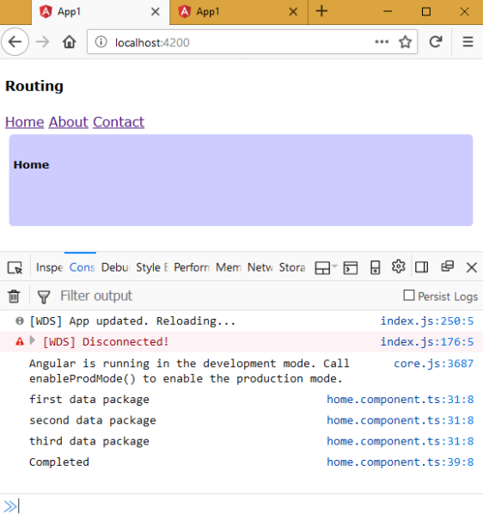
Executing the application:
Open Command Prompt and enter the following commands:
cd c:\angular\app1
ng serve
Open the browser and enter the following URL:
http://localhost:4200

Slide 11
Map
It executes the map function every time, the observable emits a value to the observer.

Slide 12
Creating Map
Observablevariable.map( (variable) => {
//do something with item and return it
});
Map - Example
Creating Application
Open Command Prompt and enter the following commands:
cd c:\angular
ng new app1
cd c:\angular\app1
ng g component India
ng g component Usa
ng g service Population

Slide 13
c:\angular\app1\src\app\population.service.ts
import { Injectable } from '@angular/core';
import { Observable, Observer } from "rxjs";
@Injectable() export class PopulationService {
myObservable: Observable<number>;
myObserver!: Observer<number>;
constructor() {
this.myObservable = new Observable((observer: Observer<number>) => {
this.myObserver = observer;
});
}
next(data:any) {
this.myObserver.next(data);
}
error() {
this.myObserver.error("some error");
}
complete() {
this.myObserver.complete();
}
}

Slide 14
c:\angular\app1\src\styles.css
.class1{
background-color:#91e3e9;
width:500px;
height:150px;
margin:20px;
float:left;
}
c:\angular\app1\src\app\app.module.ts
import { BrowserModule } from '@angular/platform-browser';
import { NgModule } from '@angular/core';
import { AppComponent } from './app.component';
import { FormsModule } from "@angular/forms";
import { IndiaComponent } from './india/india.component';
import { UsaComponent } from './usa/usa.component';
import { PopulationService } from "/population.service";
@NgModule({
declarations: [AppComponent, IndiaComponent, UsaComponent],
imports: [BrowserModule, FormsModule],
providers: [PopulationService],
bootstrap: [AppComponent]
export class AppModule {}

Slide 15
c: \angular\ app1\ src\ app\ app.component.ts
import {Component} from "@angular/core";
@Component({
selector: 'app-root',
templateUrl: './app.component.html',
styleUrls: ['./app.component.css']
}) export class AppComponent {}
c:\angular\app1\src\app\app.component.html <div class="class1">
<div>
<h4>RxJS – Custom Observables with Services with Map</h4>
<app-india> </app-india>
<app-usa> </ app-usa>
</div>

Slide 16
c:\angular\app1\src\app\india\india.component.ts
import { Component, OnInit, Inject } from '@angular/core';
import { PopulationService } from "../population.service";
@Component({
selector: 'app-india',
templateUrl: Vindia.component.htmr,
styleUrls: ['./india.component.css']
export class IndiaComponent {
population: number = 1.32;
constructor(@Inject(PopulationService) private ps: PopulationService) {
}
onIncreaseClick() {
this.population++;
this.ps.next(this.population);
}
onErrorClick() {
this.ps.error();
}
onCompleteClick() {
this.ps.complete();
}
}

Slide 17
c:\angular\app1\src\app\india\india.component.html
<div class="class1">
<h4>India</h4>
<input type="button" value="Increase" (click)="onIncreaseClick()">
<input type="button" value="Error" (click)="onErrorClick()">
<input type="button" value="Complete" (click)="onCompleteClick()">
</div>
c:\angular\app1\src\app\Usa\Usa.component.html
<div class="class1">
<h4>United States</h4>
India population: {{indiapopulation}} billion.
</div>

Slide 18
c:\angular\app1\src\app\Usa\Usa.component.ts
import( Component, OnInit, OnDestroy, Inject } from '@angular/core;
import { PopulationService } from "../population.service";
import { Subscription } from "rxjs";
import { map } from "rxjs/operators";
@Component({
selector 'app-usa',
templateUrl: './usa.component.html',
styleUrls: ['./usa.component.css']
})

Slide 19
export class UsaComponent implements OnInit, OnDestroy {
indiapopulation: number = 1.32;
subscription = new Subscription;
constructor(@ Inject(PopulationService) private ps : PopulationService){}
ngOnInit(){
this.subscription = this.ps.myObservable
.pipe(.map((item) =>{
return item * 1000;
}))
.subscribe(
(n) => {
this.indiapopulation = n;
},
(error) => {
console.log(error);
},
() => {
console.log("Completed");
});
}
ngOnDestroy(){
this.subscription.unsubscribe();
}
}

Slide 20
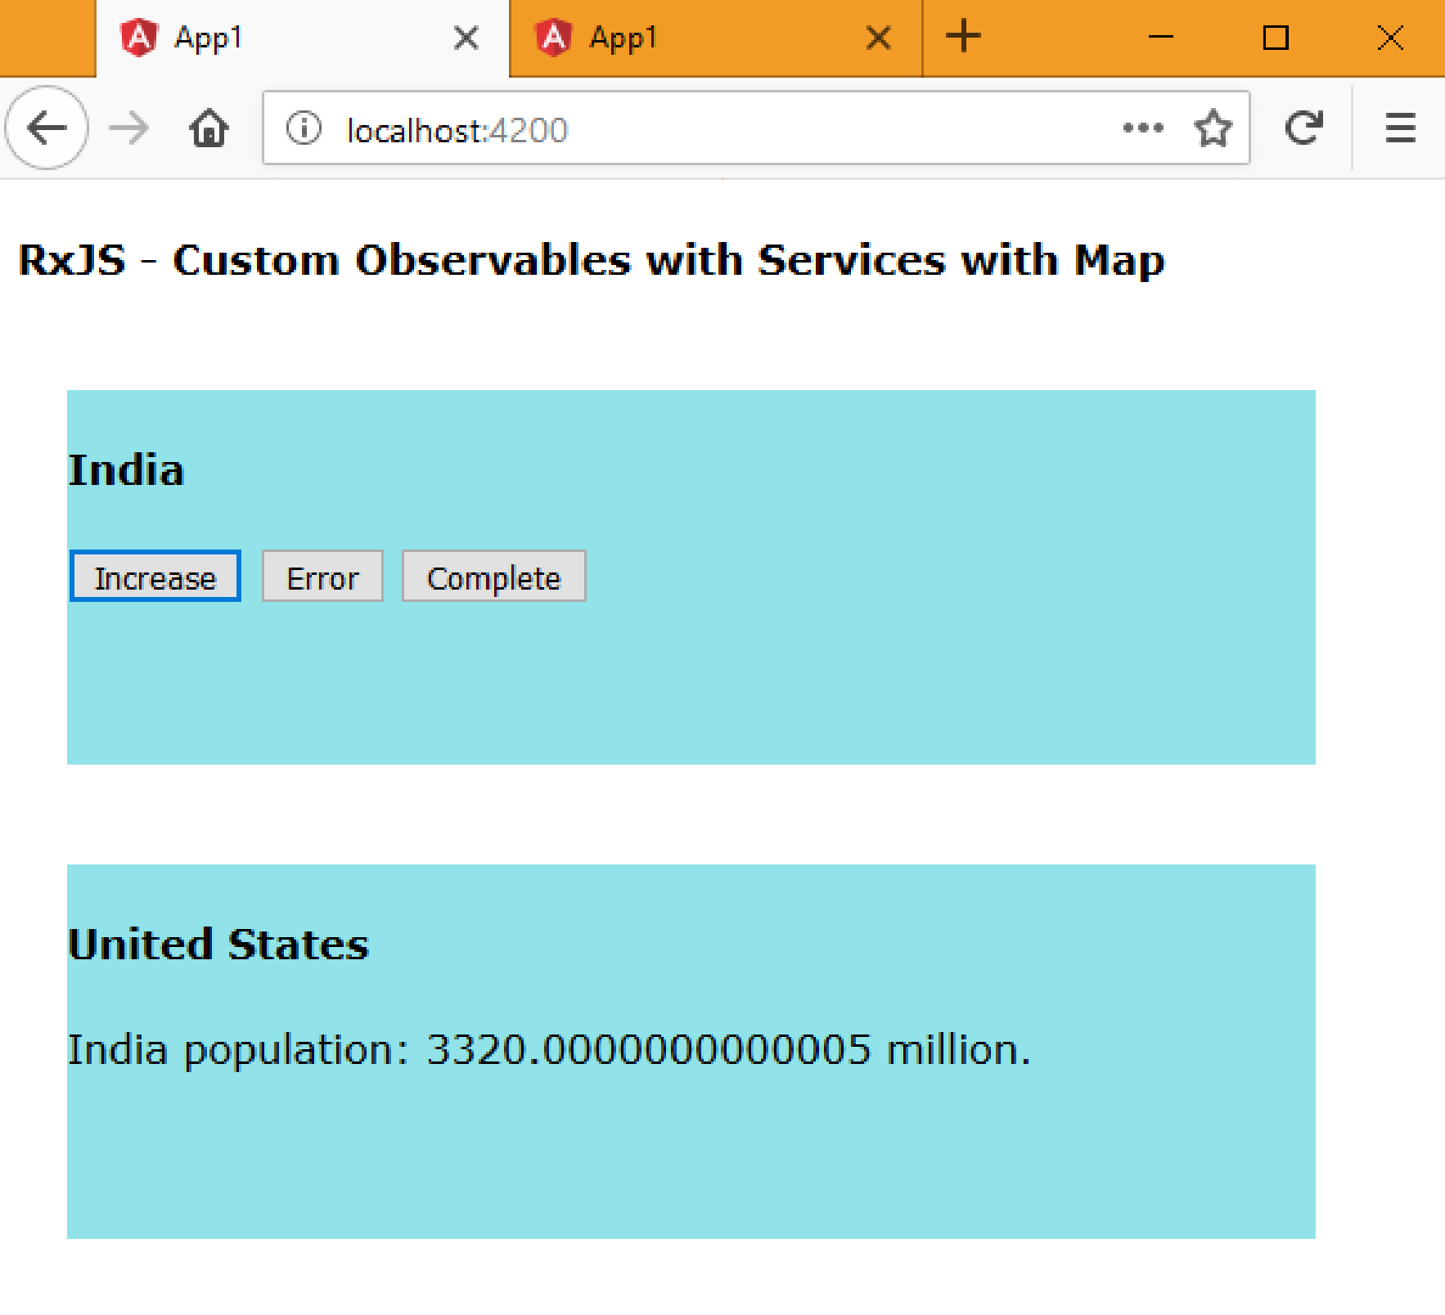
Executing the application:
Open Command Prompt and enter the following commands:
cd c:\angular\app1
ng serve
Open the browser and enter the following URL:
http://localhost:4200

Slide 21
Filter
It executes the filter function for each item when the observable emits data to the observer. If the function returns true, the value will be emitted to the observer. If the function returns false, the value will not be emitted to the observer.

Slide 22
Creating Filter
Observablevariable.filter( (variable) => {
//do something with item and return true / false
});
Filter - Example
Creating Application
Open Command Prompt and enter the following commands:
cd c:\angular
ng new app1
cd c:\angular\app1
ng g component India
ng g component Usa
ng g service Population

Slide 23
c:\angular\app1\src\app\population.service.ts
import { Injectable } from '@angular/core';
import { Observable, Observer } from "rxjs";
@Injectable() export class PopulationService {
myObservable: Observable<number>;
myObserver!: Observer<number>;
constructor() {
this.myObservable = new Observable((observer: Observer<number>) => {
this.myObserver = observer;
});
}
next(data:any) {
this.myObserver.next(data);
}
error() {
this.myObserver.error("some error");
}
complete() {
this.myObserver.complete();
}
}

Slide 24
c:\angular\app1\src\styles.css
.class1{
background-color:#91e3e9;
width:500px;
height:150px;
margin:20px;
float:left;
}
c:\angular\app1\src\app\app.module.ts
import { BrowserModule } from '@angular/platform-browser';
import { NgModule } from '@angular/core';
import { AppComponent } from './app.component';
import { FormsModule } from "@angular/forms";
import { IndiaComponent } from './india/india.component';
import { UsaComponent } from './usa/usa.component';
import { PopulationService } from "/population.service";
@NgModule({
declarations: [AppComponent, IndiaComponent, UsaComponent],
imports: [BrowserModule, FormsModule],
providers: [PopulationService],
bootstrap: [AppComponent]
export class AppModule {}

Slide 25
c: \angular\ app1\ src\ app\ app.component.ts
import {Component} from "@angular/core";
@Component({
selector: 'app-root',
templateUrl: './app.component.html',
styleUrls: ['./app.component.css']
}) export class AppComponent {}
c:\angular\app1\src\app\app.component.html <div class="class1">
<div>
<h4>RxJS – Custom Observables with Services with Filter</h4>
<app-india> </app-india>
<app-usa> </ app-usa>
</div>

Slide 26
c:\angular\app1\src\app\india\india.component.ts
import { Component, OnInit, Inject } from '@angular/core';
import { PopulationService } from "../population.service";
@Component({
selector: 'app-india',
templateUrl: Vindia.component.htmr,
styleUrls: ['./india.component.css']
export class IndiaComponent {
population: number = 1.32;
constructor(@Inject(PopulationService) private ps: PopulationService) {
}
onIncreaseClick() {
this.population++;
this.ps.next(this.population);
}
onErrorClick() {
this.ps.error();
}
onCompleteClick() {
this.ps.complete();
}
}

Slide 27
c:\angular\app1\src\app\india\india.component.html
<div class="class1">
<h4>India</h4>
<input type="button" value="Increase" (click)="onIncreaseClick()">
<input type="button" value="Error" (click)="onErrorClick()">
<input type="button" value="Complete" (click)="onCompleteClick()">
</div>
c:\angular\app1\src\app\Usa\Usa.component.html
<div class="class1">
<h4>United States</h4>
India population: {{indiapopulation}} billion.
</div>

Slide 28
c:\angular\app1\src\app\Usa\Usa.component.ts
import( Component, OnInit, OnDestroy, Inject } from '@angular/core;
import { PopulationService } from "../population.service";
import { Subscription } from "rxjs";
import { filter} from "rxjs/operators";
@Component({
selector 'app-usa',
templateUrl: './usa.component.html',
styleUrls: ['./usa.component.css']
})
export class UsaComponent implements OnInit, OnDestroy {
indiapopulation: number = 1.32;
subscription = new Subscription;
constructor(@ Inject(PopulationService) private ps : PopulationService){}

Slide 29
ngOnInit(){
this.subscription = this.ps.myObservable
.pipe(.filter((item) =>{
if(parseInt(String(item)) % 2 == 0){
return true;
}else{
return false;
}
}))
.subscribe(
(n) => {
this.indiapopulation = n;
},
(error) => {
console.log(error);
},
() => {
console.log("Completed");
});
}
ngOnDestroy(){
this.subscription.unsubscribe();
}
}

Slide 30
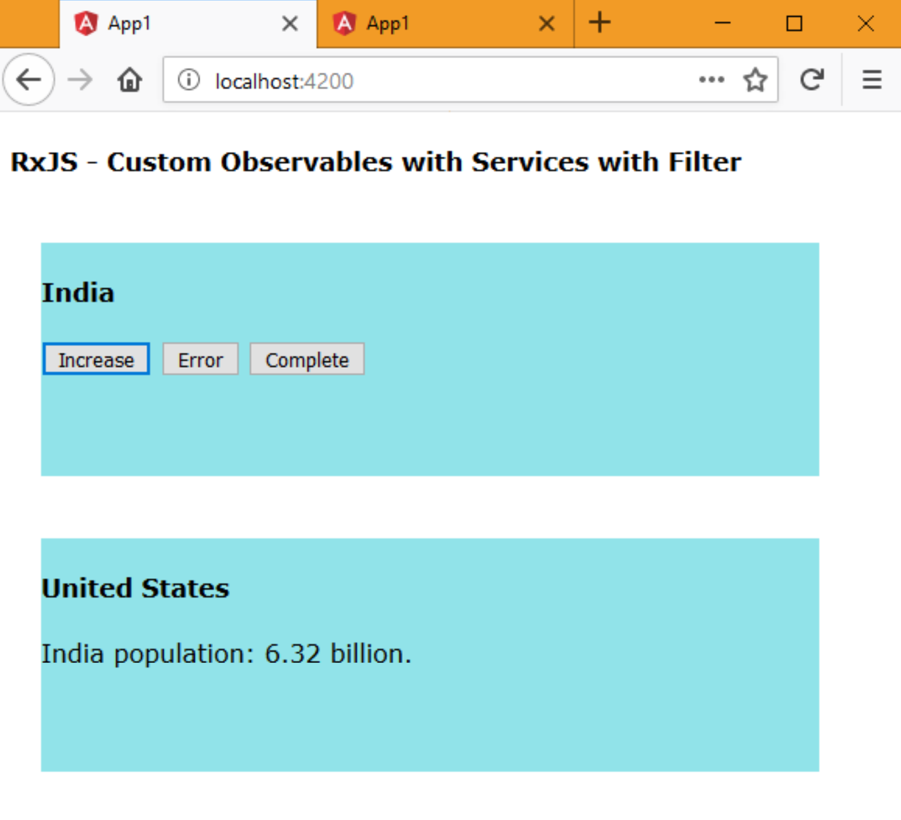
Executing the application:
Open Command Prompt and enter the following commands:
cd c:\angular\app1
ng serve
Open the browser and enter the following URL:
http://localhost:4200

Slide 31
Take
It executes the emits only the specified no. of data packets maximum to the observer.

Slide 32
Creating Take
Observablevariable.take( n);
Take - Example
Creating Application
Open Command Prompt and enter the following commands:
cd c:\angular
ng new app1
cd c:\angular\app1
ng g component India
ng g component Usa
ng g service Population

Slide 33
c:\angular\app1\src\app\population.service.ts
import { Injectable } from '@angular/core';
import { Observable, Observer } from "rxjs";
@Injectable() export class PopulationService {
myObservable: Observable<number>;
myObserver!: Observer<number>;
constructor() {
this.myObservable = new Observable((observer: Observer<number>) => {
this.myObserver = observer;
});
}
next(data:any) {
this.myObserver.next(data);
}
error() {
this.myObserver.error("some error");
}
complete() {
this.myObserver.complete();
}
}

Slide 34
c:\angular\app1\src\styles.css
.class1{
background-color:#91e3e9;
width:500px;
height:150px;
margin:20px;
float:left;
}
c:\angular\app1\src\app\app.module.ts
import { BrowserModule } from '@angular/platform-browser';
import { NgModule } from '@angular/core';
import { AppComponent } from './app.component';
import { FormsModule } from "@angular/forms";
import { IndiaComponent } from './india/india.component';
import { UsaComponent } from './usa/usa.component';
import { PopulationService } from "/population.service";
@NgModule({
declarations: [AppComponent, IndiaComponent, UsaComponent],
imports: [BrowserModule, FormsModule],
providers: [PopulationService],
bootstrap: [AppComponent]
export class AppModule {}

Slide 35
c: \angular\ app1\ src\ app\ app.component.ts
import {Component} from "@angular/core";
@Component({
selector: 'app-root',
templateUrl: './app.component.html',
styleUrls: ['./app.component.css']
}) export class AppComponent {}
c:\angular\app1\src\app\app.component.html
<div class="class1">
<h4>RxJS – Custom Observables with Services with Take</h4>
<app-india> </app-india>
<app-usa> </ app-usa>
</div>

Slide 36
c:\angular\app1\src\app\india\india.component.ts
import { Component, OnInit, Inject } from '@angular/core';
import { PopulationService } from "../population.service";
@Component({
selector: 'app-india',
templateUrl: Vindia.component.htmr,
styleUrls: ['./india.component.css']
export class IndiaComponent {
population: number = 1.32;
constructor(@Inject(PopulationService) private ps: PopulationService) {
}
onIncreaseClick() {
this.population++;
this.ps.next(this.population);
}
onErrorClick() {
this.ps.error();
}
onCompleteClick() {
this.ps.complete();
}
}

Slide 37
c:\angular\app1\src\app\india\india.component.html
<div class="class1">
<h4>India</h4>
<input type="button" value="Increase" (click)="onIncreaseClick()">
<input type="button" value="Error" (click)="onErrorClick()">
<input type="button" value="Complete" (click)="onCompleteClick()">
</div>
c:\angular\app1\src\app\Usa\Usa.component.html
<div class="class1">
<h4>United States</h4>
India population: {{indiapopulation}} billion.
</div>

Slide 38
c:\angular\app1\src\app\Usa\Usa.component.ts
import( Component, OnInit, OnDestroy, Inject } from '@angular/core;
import { PopulationService } from "../population.service";
import { Subscription } from "rxjs";
import { take } from "rxjs/operators";
@Component({
selector 'app-usa',
templateUrl: './usa.component.html',
styleUrls: ['./usa.component.css']
})
export class UsaComponent implements OnInit, OnDestroy {
indiapopulation: number = 1.32;
subscription = new Subscription;
constructor(@ Inject(PopulationService) private ps : PopulationService){}

Slide 39
ngOnInit(){
this.subscription = this.ps.myObservable
.pipe(.take(3))
.subscribe(
(n) => {
this.indiapopulation = n;
},
(error) => {
console.log(error);
},
() => {
console.log("Completed");
});
}
ngOnDestroy(){
this.subscription.unsubscribe();
}
}

Slide 40
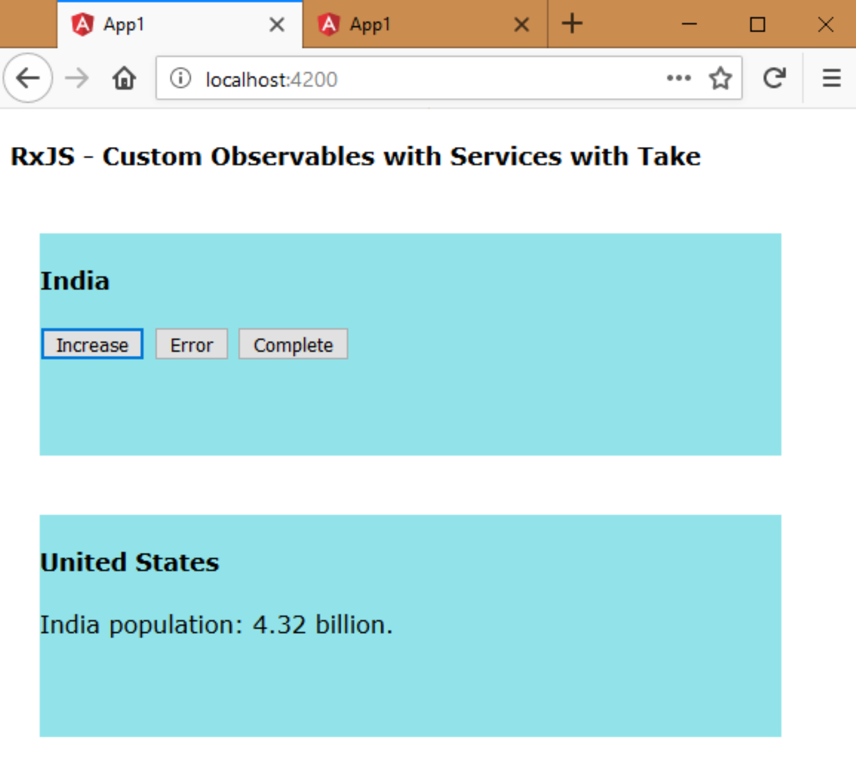
Executing the application:
Open Command Prompt and enter the following commands:
cd c:\angular\app1
ng serve
Open the browser and enter the following URL:
http://localhost:4200

Slide 41
Skip
It executes the skips the specified no. of data packets, and emits the remaining data packets to the observer.

Slide 42
Creating Skip
Observablevariable.skip( n);
Skip - Example
Creating Application
Open Command Prompt and enter the following commands:
cd c:\angular
ng new app1
cd c:\angular\app1
ng g component India
ng g component Usa
ng g service Population

Slide 43
c:\angular\app1\src\app\population.service.ts
import { Injectable } from '@angular/core';
import { Observable, Observer } from "rxjs";
@Injectable() export class PopulationService {
myObservable: Observable<number>;
myObserver!: Observer<number>;
constructor() {
this.myObservable = new Observable((observer: Observer<number>) => {
this.myObserver = observer;
});
}
next(data:any) {
this.myObserver.next(data);
}
error() {
this.myObserver.error("some error");
}
complete() {
this.myObserver.complete();
}
}

Slide 44
c:\angular\app1\src\styles.css
.class1{
background-color:#91e3e9;
width:500px;
height:150px;
margin:20px;
float:left;
}
c:\angular\app1\src\app\app.module.ts
import { BrowserModule } from '@angular/platform-browser';
import { NgModule } from '@angular/core';
import { AppComponent } from './app.component';
import { FormsModule } from "@angular/forms";
import { IndiaComponent } from './india/india.component';
import { UsaComponent } from './usa/usa.component';
import { PopulationService } from "/population.service";
@NgModule({
declarations: [AppComponent, IndiaComponent, UsaComponent],
imports: [BrowserModule, FormsModule],
providers: [PopulationService],
bootstrap: [AppComponent]
export class AppModule {}

Slide 45
c: \angular\ app1\ src\ app\ app.component.ts
import {Component} from "@angular/core";
@Component({
selector: 'app-root',
templateUrl: './app.component.html',
styleUrls: ['./app.component.css']
}) export class AppComponent {}
c:\angular\app1\src\app\app.component.html
<div class="class1">
<h4>RxJS – Custom Observables with Services with Skip</h4>
<app-india> </app-india>
<app-usa> </ app-usa>
</div>

Slide 46
c:\angular\app1\src\app\india\india.component.ts
import { Component, OnInit, Inject } from '@angular/core';
import { PopulationService } from "../population.service";
@Component({
selector: 'app-india',
templateUrl: Vindia.component.htmr,
styleUrls: ['./india.component.css']
export class IndiaComponent {
population: number = 1.32;
constructor(@Inject(PopulationService) private ps: PopulationService) {
}
onIncreaseClick() {
this.population++;
this.ps.next(this.population);
}
onErrorClick() {
this.ps.error();
}
onCompleteClick() {
this.ps.complete();
}
}

Slide 47
c:\angular\app1\src\app\india\india.component.html
<div class="class1">
<h4>India</h4>
<input type="button" value="Increase" (click)="onIncreaseClick()">
<input type="button" value="Error" (click)="onErrorClick()">
<input type="button" value="Complete" (click)="onCompleteClick()">
</div>
c:\angular\app1\src\app\Usa\Usa.component.html
<div class="class1">
<h4>United States</h4>
India population: {{indiapopulation}} billion.
</div>

Slide 48
c:\angular\app1\src\app\Usa\Usa.component.ts
import( Component, OnInit, OnDestroy, Inject } from '@angular/core;
import { PopulationService } from "../population.service";
import { Subscription } from "rxjs";
import { skip } from "rxjs/operators";
@Component({
selector 'app-usa',
templateUrl: './usa.component.html',
styleUrls: ['./usa.component.css']
})
export class UsaComponent implements OnInit, OnDestroy {
indiapopulation: number = 1.32;
subscription = new Subscription;
constructor(@ Inject(PopulationService) private ps : PopulationService){}

Slide 49
ngOnInit(){
this.subscription = this.ps.myObservable
.pipe(.skip(3))
.subscribe(
(n) => {
this.indiapopulation = n;
},
(error) => {
console.log(error);
},
() => {
console.log("Completed");
});
}
ngOnDestroy(){
this.subscription.unsubscribe();
}
}

Slide 50
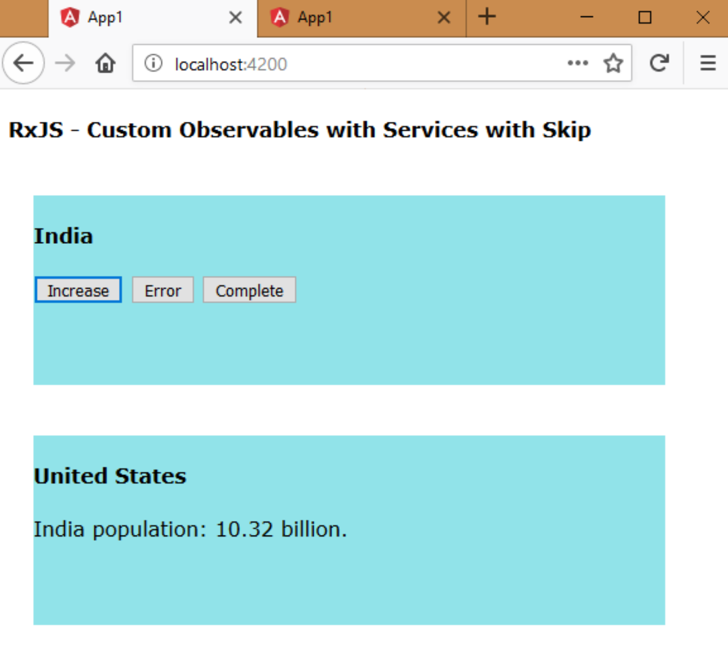
Executing the application:
Open Command Prompt and enter the following commands:
cd c:\angular\app1
ng serve
Open the browser and enter the following URL:
http://localhost:4200

